Slide 1


ITC Hotels Analysis
Presented By : Sneha Patel
Cohort 4

Slide 2
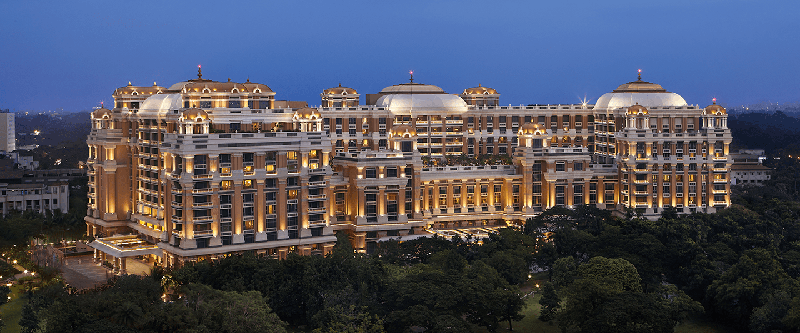

Slide 3

ITC Hotels Analysis
ITC Hotels is one of India’s premier luxury hotel chains, recognized for blending traditional Indian hospitality with world-class service standards. Operating under the ethos of “Responsible Luxury,” ITC Hotels focuses on sustainability, luxury, and excellence. With properties spanning across metropolitan and regional cities, ITC offers a diverse range of accommodations—from elite to standard—serving both business and leisure travelers.

Slide 4
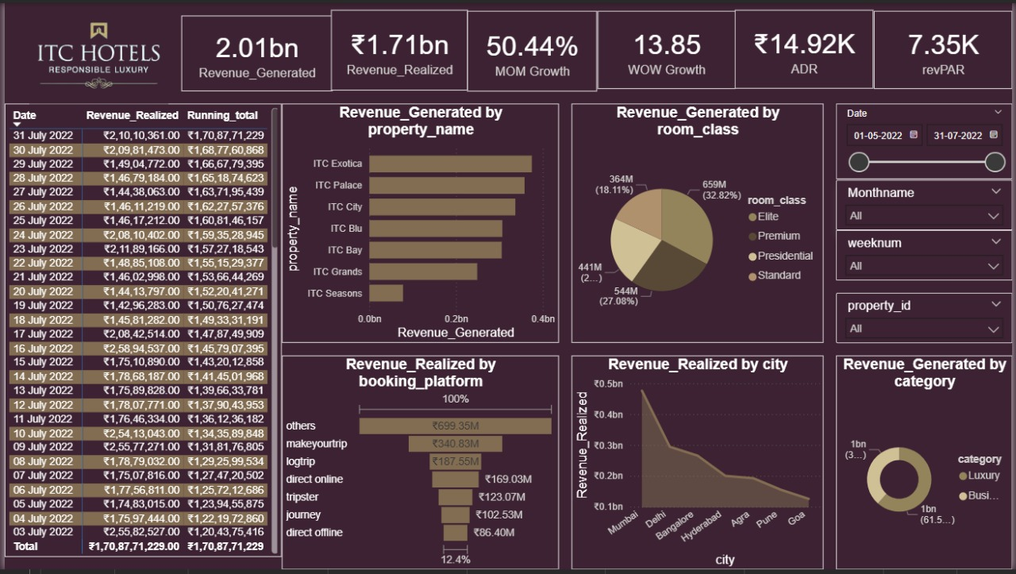

Slide 5

ITC Hotels Analysis
Revenue Analysis
1.Highest Revenue Month: Revenue July
2.Top Booking Days: Sundays generated the highest revenue.
3.Best Performing Properties: ITC Exotica, ITC Palace,
4.ITC City Top Room Class by Revenue: Elite rooms (32.82%)
5.Booking Platforms: “Others” and MakeMyTrip contributed most.
6.Category-wise: Luxury category far outperformed Business.
7.City-wise: Mumbai, Delhi, Bangalore led in revenue.

Slide 6
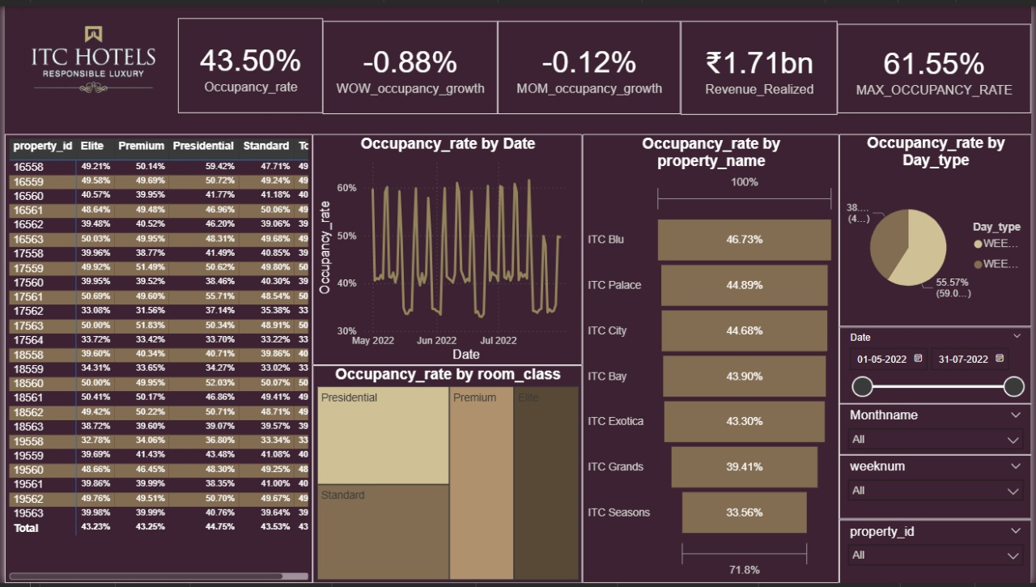

Slide 7
ITC Hotels Analysis
Occupancy Analysis
Overall Occupancy: 43.50%
Top Occupied Room Classes: Presidential & Premium
Top Property by Occupancy: ITC Blu (46.73%)
Lowest Occupancy: ITC Seasons (33.56%)
Weekend vs Weekday: Weekends had much higher occupancy (55.57%) than weekdays (38.45%).
Growth: Slight negative trend in occupancy WoW (-0.88%) and MoM (-0.12%)

Slide 8
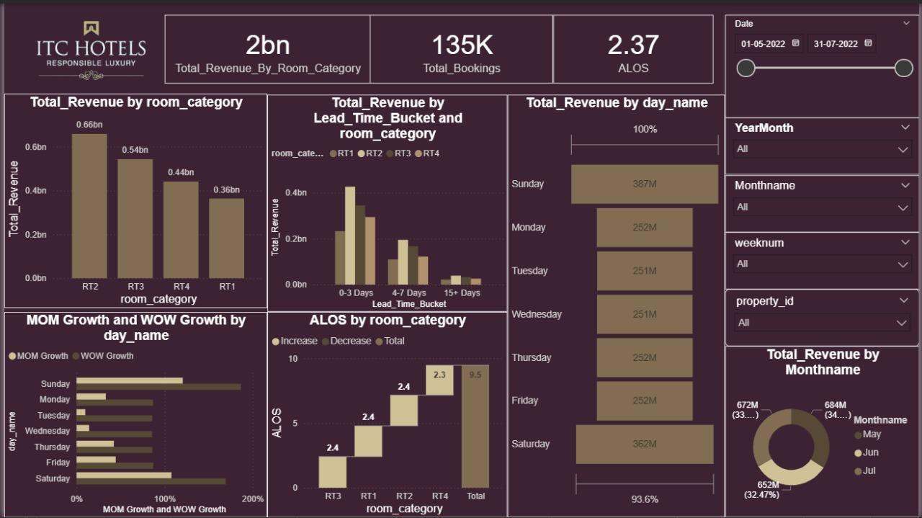

Slide 9

ITC Hotels Analysis
Booking Analysis
Total Bookings : 135k
ALOS: 2.37 days
Booking Window: 0–3 days most common lead time.
Top Lead Time Segment: 0–3 days (indicative of impulsive or short-term booking behavior).
Days with Most Bookings: Saturday, Sunday, and Monday were most active.

Slide 10
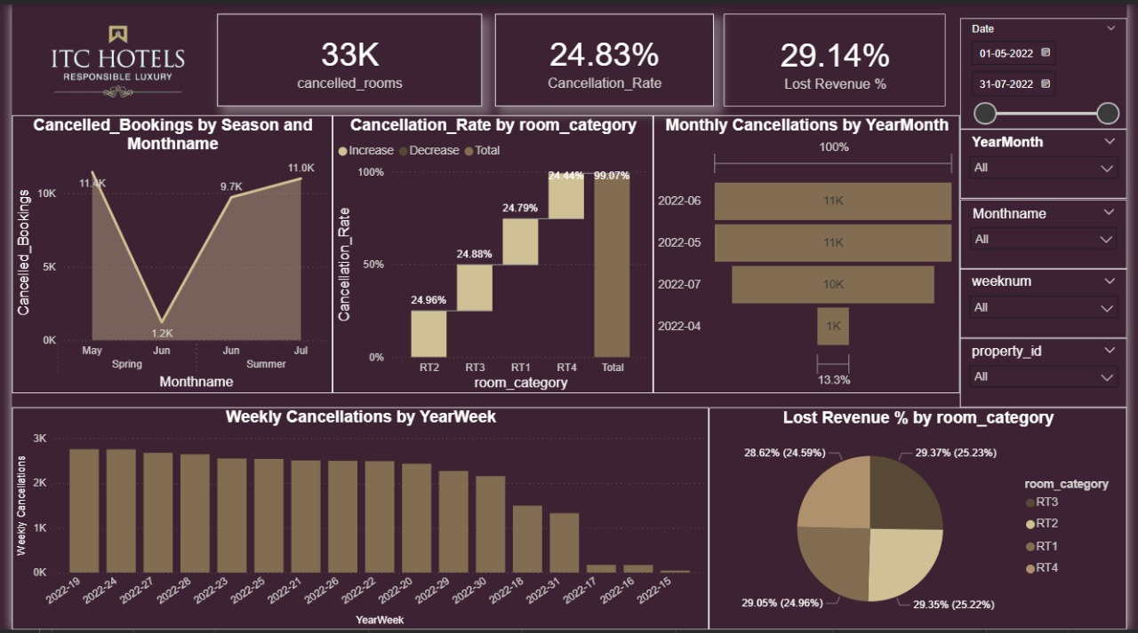

Slide 11

ITC Hotels Analysis
Cancellation Analysis
Total Cancelled Rooms: 33K
Cancellation %: 24.83%
Lost Revenue: 29.14% of potential revenue lost due to cancellations.Peak
Cancellation Months: May and July
High-Cancellation Room Categories: RT3 and RT4High
Cancellation Weeks: Week 19–24

Slide 12
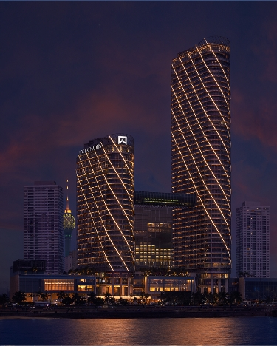
ITC Hotels Analysis
Overall Dashboard
Total Revenue Generated: ₹2.01B
Revenue Realized: ₹1.71B
Growth: MoM up by 50.44%, WoW up by 13.85%
Total Bookings: 135K
Cancellation Rate: 24.83%
Occupancy: 43.5%

Slide 13

Strategic Recommendations
Leverage High-Performing Platforms: Increase collaborations and promotions on MakeMyTrip and other top platforms.
Target High-Revenue Cities: Focus marketing and promotions in cities like Mumbai, Delhi, and Bangalore.
Reduce Cancellations: Introduce better cancellation policies and incentives for non-refundable bookings.
Boost Weekday Occupancy: Consider offering weekday deals or packages to balance occupancy rates.
Optimize Room Classes: Analyze underperforming room classes (e.g., Standard, RT4) for potential upgrades or targeted promotions.

Slide 14
Thanks For Connecting

